Slide 1
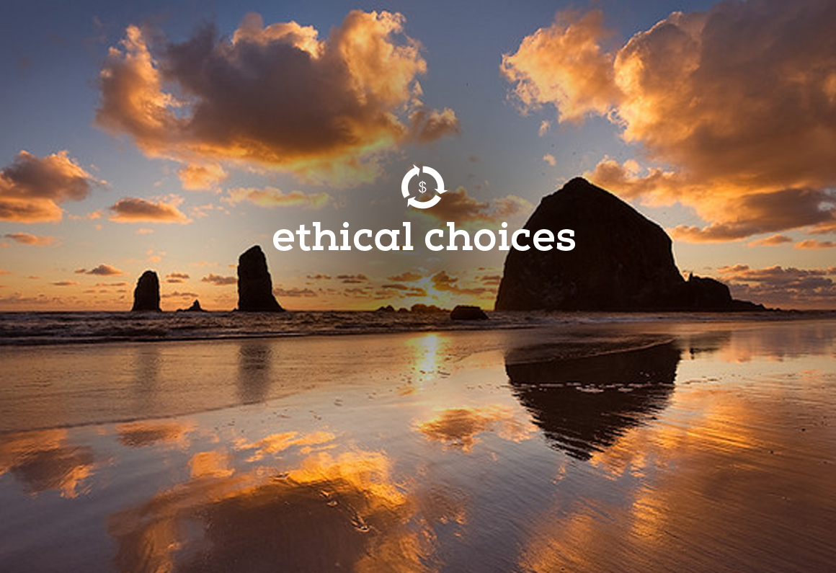
Jung le Han
Sean Walsh
Michael Galhouse
Taizoon Doctor

Slide 2
Problem
Products and services that live up to your values are available in your community, but are not easy to find.
Mission
Easy and credible way to discover, purchase, promote, and comment on products & services that support issues you care about:
Environmental
Economic
Social Justice

Slide 3
Introducing Ethical Choices
A wiki-based platform devoted to
guiding the invisible hand to support the values you cherish.
Wikis for each product and company
Populated from public data and news
Monitored and maintained by user community
Includes a meaningful rating system for each major criteria
Start with local focus on Oregon and build out

Slide 4
Impact
Democracy through economics
Empowers consumers
Choices not dictated by mass retail
Not dependant on government regulations, laws, and courts to protect our health, environment, & equality
Ethical choices of products and services by a small, but conscientious set of consumers motivates good business practices

Slide 5
Criteria
Economic
Ownership
Geographic impact
Certifications
Environmental
Production
Sourcing
Certifications/violations
Social
Health
Employment practices & employee dignity
Community engagement

Slide 6
Initial Data Sources
Listing of businesses in oregon:
http://www.filinginoregon.com/pages/business_registry/research/business_complaints.html
Environmental violations:
http://www.deq.state.or.us/programs/enforcement/nonquery.asp
Local impact:
www.supportland.com
Employee Health:
http://www.indeed.com/Best-Places-to-Work/Oregon

Slide 7
Demo

Slide 8

NDoCH Objective:
Public Data + Personal Need = Value
Ethical Choices
Corporate & Product Data + Personal Values = Healthy Society

